Slide 1
User Data Analysis with Data Mining
Péter Ivanics
Monday 4. December 2017
Peter.ivanics@helsinki.fi

Slide 2
Outline
Introduction
Research questions & methods
User data
Related studies
Addressing reviewers’ feedback
Conclusions

Slide 3
Introduction
Data is commonly collected about and from users
Demographic data and software usage data can be used research purposes
Challenges:
Domain-dependent in nature
Volume
Goals:
To understand the concept of user data
To analyze how user data is utilized
To identify tendencies between demographic groups and engaging content

Slide 4
Research questions & methods
RQ1: How is user data understood in previous research?
RQ2: How data mining methods are utilized for user data analysis in scientific researches?
Digital libraries:
ACM digital library,
IEEE Xplore,
Google Scholar
Search keywords: "data mining", "social media", "user data", "user behavior", "demographic characteristics" and "digital footprints”

Slide 5
User data
User behavior is vaguely defined in researches
Various studies utilize user demographic and software usage data
There is no common on concepts/terms in this area

Slide 6
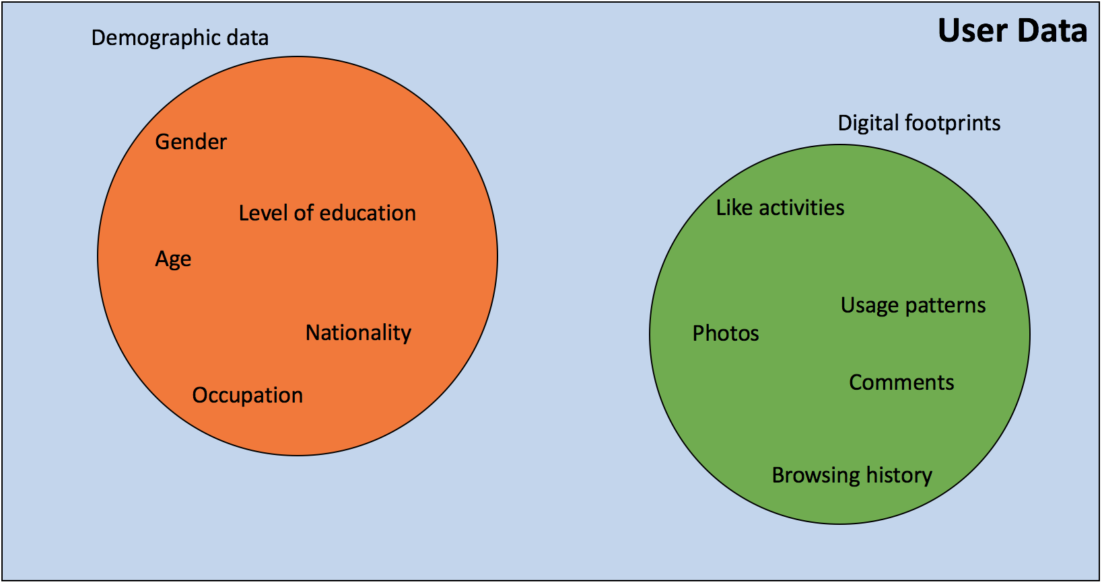

Slide 7
Related studies
Wide range of domains:
Social media sites
Ratings in online movie databases
Online banking
Application areas:
Identifying engaging content and features
Analyzing gender differences
Improving marketing processes

Slide 8
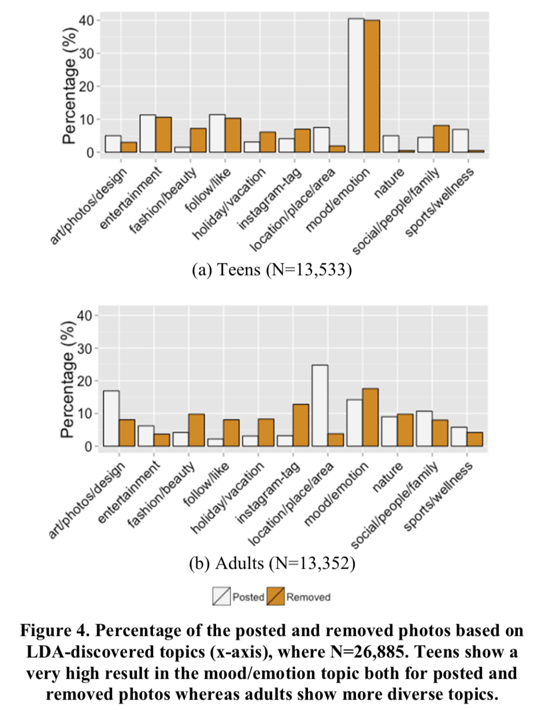
Age & gender differences
Source: Jang et al. - Teens Engage More with Fewer Photos: Temporal and Comparative Analysis on Behaviors in Instagram

Slide 9
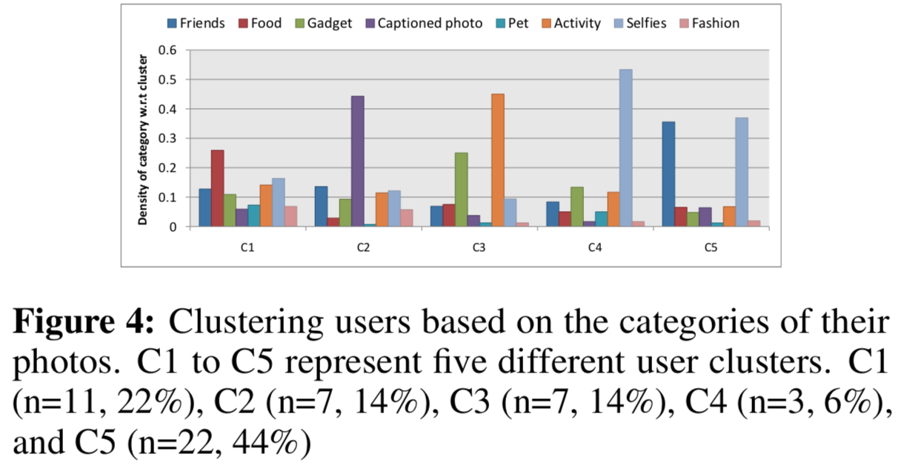
User clusters
Source: Y. Hu, L. Manikonda, S. Kambhampati - What We Instagram: A First Analysis of Instagram Photo Content and User Types
Notes:
Specialists vs generalists

Slide 10
Tools and techniques
Combination of multiple data sources
Enhancing the existing data in some way
Technique | Number of studies
Computer vision | 3
Text/Natural language processing | 5
Unsupervised machine learning | 2
Supervised machine learning | 5
Frequent Itemset Analysis | 1

Slide 11
Addressing reviewers’ Feedback
Q: Why not to limit the amount of data and focus only on relevant data instead of collecting more and using Data Mining techniques?
A: Not realistic to analyze everything with manual labor; Computers work faster and more reliably in this kind of problem solving; Time-efficiency and potential gain on new insights
Q: What do we learn from the individual results, when viewed together?
A: Wide applicability of the methods; Similar results among multiple papers
Ethics

Slide 12
Conclusions
User data is widely present across application areas
Easy to collect, users are ready to give
Analysis tools and use cases vary because of domain-dependent nature – there is no silver bullet
User data can be reliably used for various purposes
Ethics and privacy are important aspects

Slide 13
Questions?
Péter Ivanics
Peter.ivanics@helsinki.fi

